Slide 1
Group Project Phase III:
Authentic By Zee
By Mitchell Roberts, Reem Ghabayen, Jyoti Ranjan, and Skyler Groglio
Notes:
REEM

Slide 2

Introduction
Authentic By Zee
Catering service and plate sales
2019: Acquired mobile food trailer
Jamaican and Carribean Cuisine
Notes:
REEM

Slide 3
KPIs
Increase Profitability
Pinpoint best days of the week/months to sell + best weather
Optimize locations - Statesville, Mt. Airy, Charlotte
Traffic and demographic data with Tableau
Analyze which items are most profitable
Exploratory visualizations with R
Improve Data Collection
Build customer profiling database
Gather more sales data for future Association Rule Mining analysis
Notes:
REEM

Slide 4
Data Analysis Roadmap
Descriptive/Diagnostic
Popular food items
Relation of order with day of week
Seasonal trend analysis (monthly)
Identify high-traffic areas
Predictive
Cash flow projection
Notes:
REEM

Slide 5
Data Analysis Roadmap
Prescriptive
Profitability: Reduce food loss / Cost reduction
Improve scheduling / geo location for the truck placement
Build customer profiling database (marketing)
Notes:
REEM

Slide 6
Descriptive Analytics: Data Collection Methods
Primary data collection: Sales
Hands-on as sales are conducted in real time
Squareup
Data has been pulled from this source into CSV files
KPI Relation:
Profit Analysis, popular items, best days/months to sell which items
Notes:
SKYLER: SquareUp has their own POS (point of service) system, so transactions can be easily tracked and uploaded to their database in real time. Data was very quick to process for analysis in Python/R since it’s in a static CSV file, but if we want the most up to date information, we’d have to extract the data again and rerun our model every time we want to perform subsequent analysis. Still useful for our KPIs, as the local CSV files allows us to perform profit analysis, identify items etc.. with minimal processing power at no cost.

Slide 7
Descriptive Analytics: Data Collection Methods
Secondary data collection: Mecklenburg and Iredell Counties
Demographics
CSV: North Carolina Public database
Traffic
XLSX: Annual Average Daily Traffic (AADT) per section of each highway
KPI Relation:
Assists with location optimization
Notes:
SKYLER: Scraped secodonary data.. ABZ currently operates in Statesville, Mt. Airy, and Charlotte. Zhara is not looking to expand anywhere else right now, since she’s concerned about the hidden costs associated with gas and travel time along her current route. We want to help refine her location schedule and guide her truck to areas that aren’t too far away from her, and also have a higher volumes of potential customers.

Slide 8
Dataset Characteristics: Sales
Multiple CSV files pulled from SquareUp
~2,000 rows of transactional data
Spanning from 2018-2020
5 Tables per Year
“Category Sales”
“Item Sales Summary”
“Items”
“Payment Method Summary”
“Transactions”
Notes:
SKYLER: We decided the “Item Sales Summary” and “Category Sales” tables weren’t helpful for our analysis, since we already had all the information we needed from the columns in the “Items” and “Transactions” tables to aggregate and perform visualizations on our own. So, what we decided to do was concatenate the Items tables from 2018-2020 into one master table and then do the same for the Transactions tables. All of our descriptive and predictive analysis were based on these two transformed tables.

Slide 9
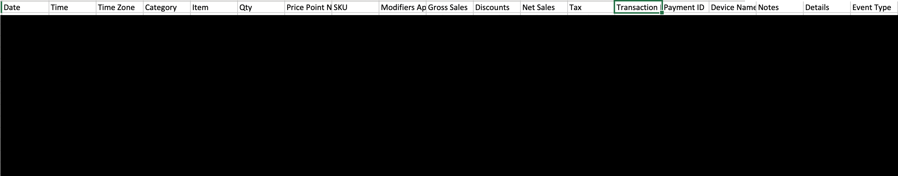
Sales Data Characteristics: "Items”
Additional columns: Location (ABZ), Dining Option, Customer ID, Customer Name, Customer Reference ID, Unit, Count
Notes:
SKYLER: This is the primary table we used to perform our analysis. The actual cells are blacked out for privacy reasons, but each row is representative of one food, drink, plate, or pan purchase. Since the data is collected in real time on Squareup, we have the date and time down to the very second that the item was purchased. The category of food is also listed, which we used to further break down sales in our analysis. Lastly, the gross sales, net sales, taxes, and discounts are listed too.

Slide 10
Sales Data Characteristics: "Transactions”
Additional columns: Fees, Net Total, TransactionID, PaymentID, Card Brand, PAN Suffix, Device Name, Staff Name, Staff ID, Details, Description, Event Type, Location, Dining Option, Customer ID, Customer Name, Customer Reference ID, Device Nickname, Deposit ID, Deposit Date, Deposit Details, Fee Percentage, Fee Fixed Rate, Refund Reason, Discount Name, Transaction Status
Notes:
SKYLER: very similar to the items table, but instead of any food item columns, we have additional numerical information like tips, partial refunds, and the fees that the credit card companies would charge ABZ after a transaction. Unfortunately, the only customer data we have within these tables is their names, which isn’t enough information to perform segmentation or profiling on their customer base. We’ll talk about our strategies to remedy at the end of our presentation.

Slide 11
Traffic Dataset Characteristics
Sourced from NC Department of Transportation (semi public)
5 Columns: Location ID, County, Route, Location, Collection Year (2002-2019)*
Details average amount of cars that traveled through sections of counties’ highways per day
86 Rows Total:
Iredell County: 48
Mecklenburg County: 38
Mecklenburg County had 15 missing cells of traffic data for 2019 (39%)
Imputation performed in the source file using synthetic distribution method: average of past two available years
Notes:
Filtered out all counties except M and I. No dedicated column for # of cars, under “year”. Car amount rounded up or down by 500.
Imputation didn’t translate to tableau visualization (we’ll show later), but we could at least confidently estimate that there were wasn’t actually a sharp decline in Mecklenburg traffic during 2019.

Slide 12






Descriptive and Predictive Analytics
Tools/Packages used
Microsoft Excel
Jupyter Notebook
Python
Numpy
Pandas
Matplotlib
Prophet - additive regression model
R for association rule
Tableau

Slide 13
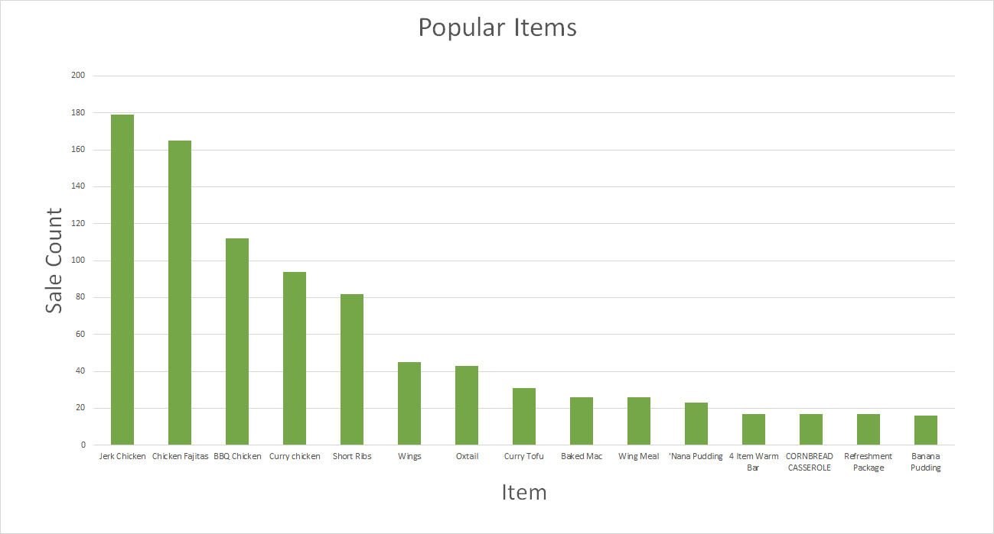
Descriptive Analytics: Items by Popularity
Notes:
Note: Oxtail is lower in popularity on the graph due to some of the sales being categorized as a “Custom Items”

Slide 14
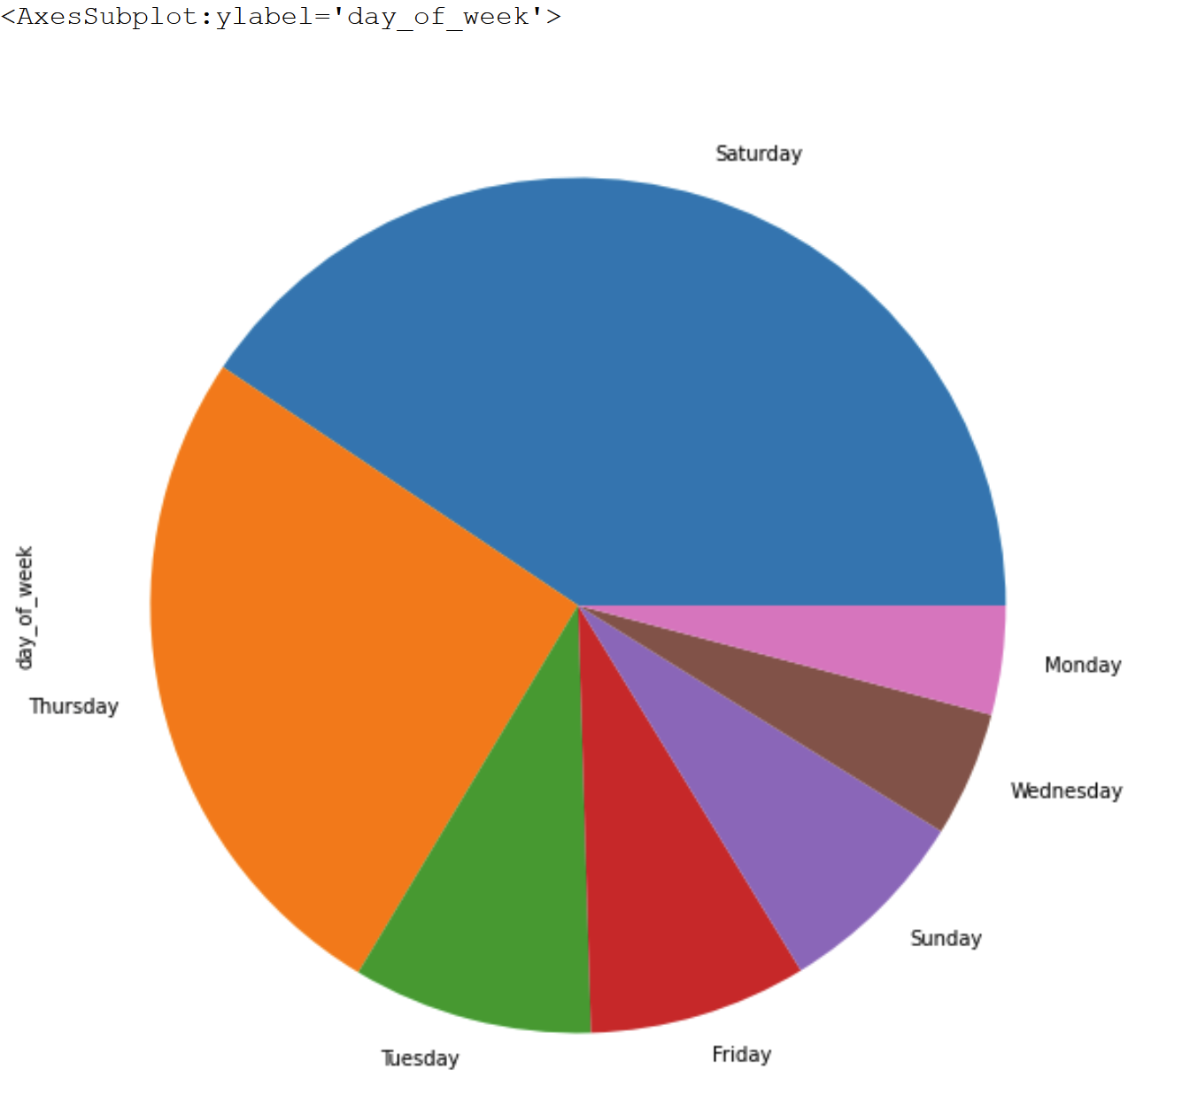
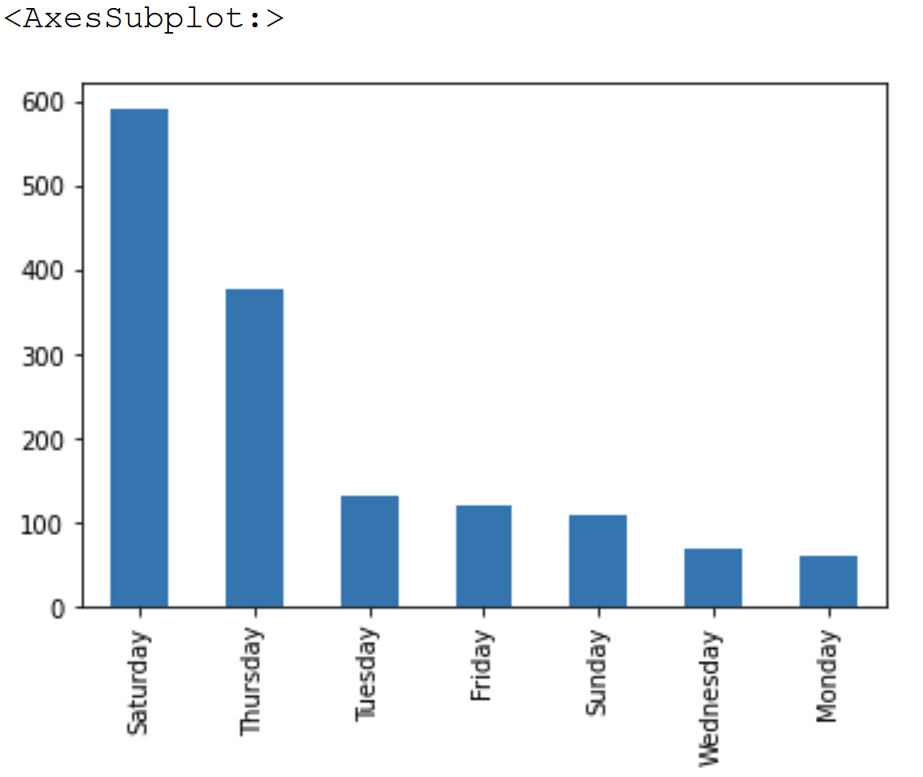
Descriptive Analytics: Best Days of the Week for Sales
Notes:
These models show us the best days of the week for sales. We see Saturday across the years of data that we have are ABZee’s busiest days next to thursday.

Slide 15
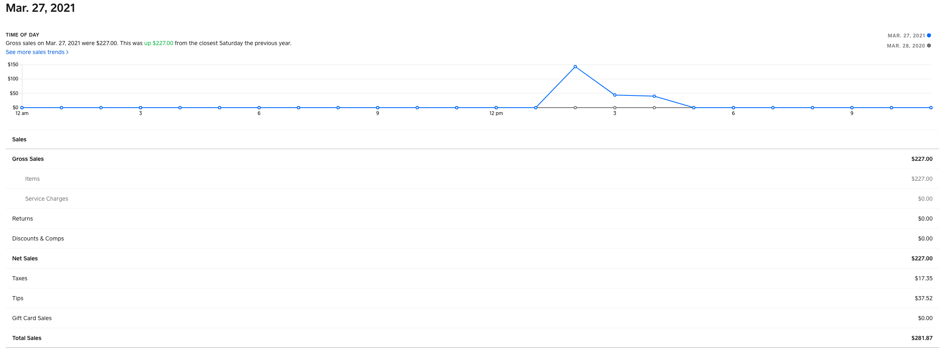
Descriptive: How Weather Effects ABZee
Total Sales = $280
The below link shows weather data for March 27, 2021
ABZee catered this event which we predicted would have stunted sales due to adverse conditions
Let's take a look
Notes:
March 27 was a saturday which we determined in the pervious slides were typically good days. With this, we have to also acknowledge that ABZee had some competition that day.

Slide 16
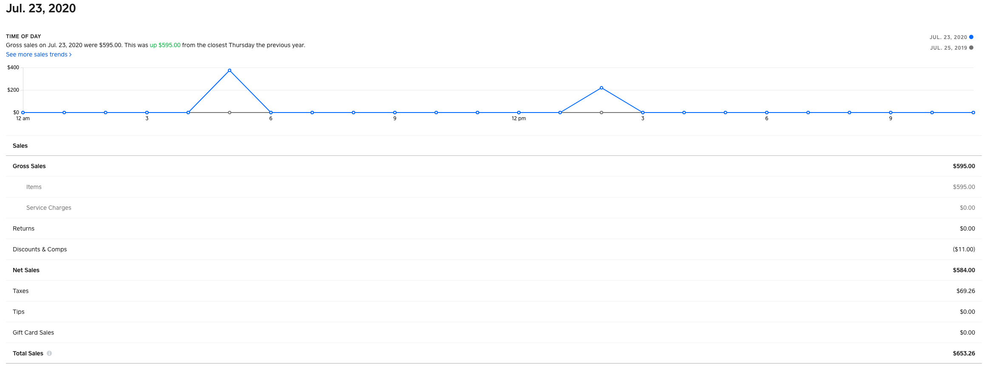
Descriptive: How Weather Effects ABZee
Now let's look at a day that had good weather
Total Sales = $650
A difference of over 40%

Slide 17
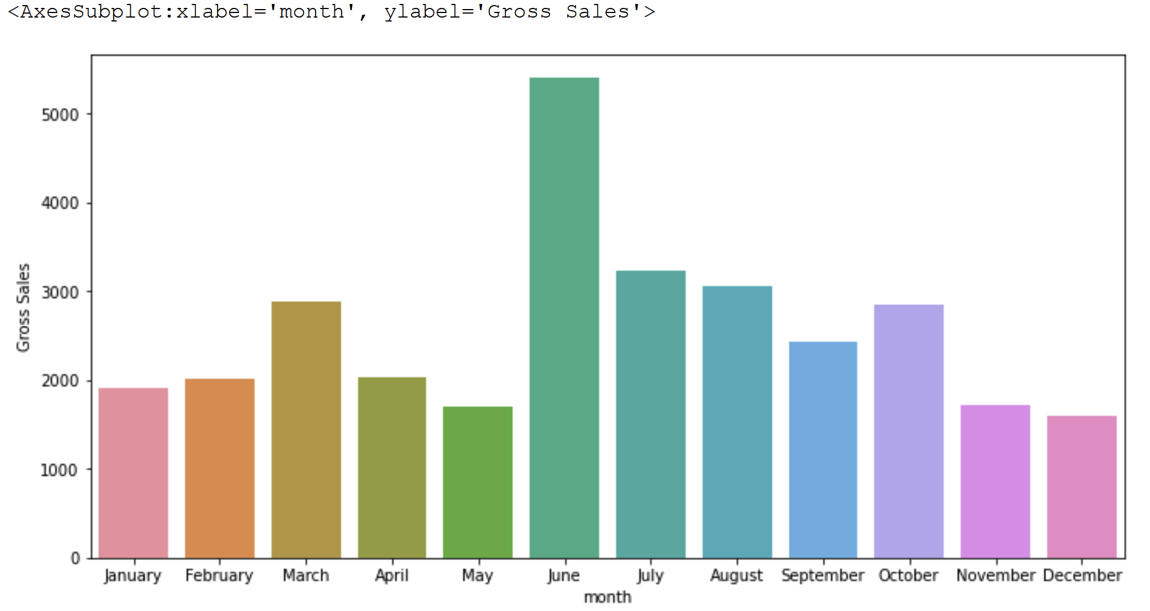
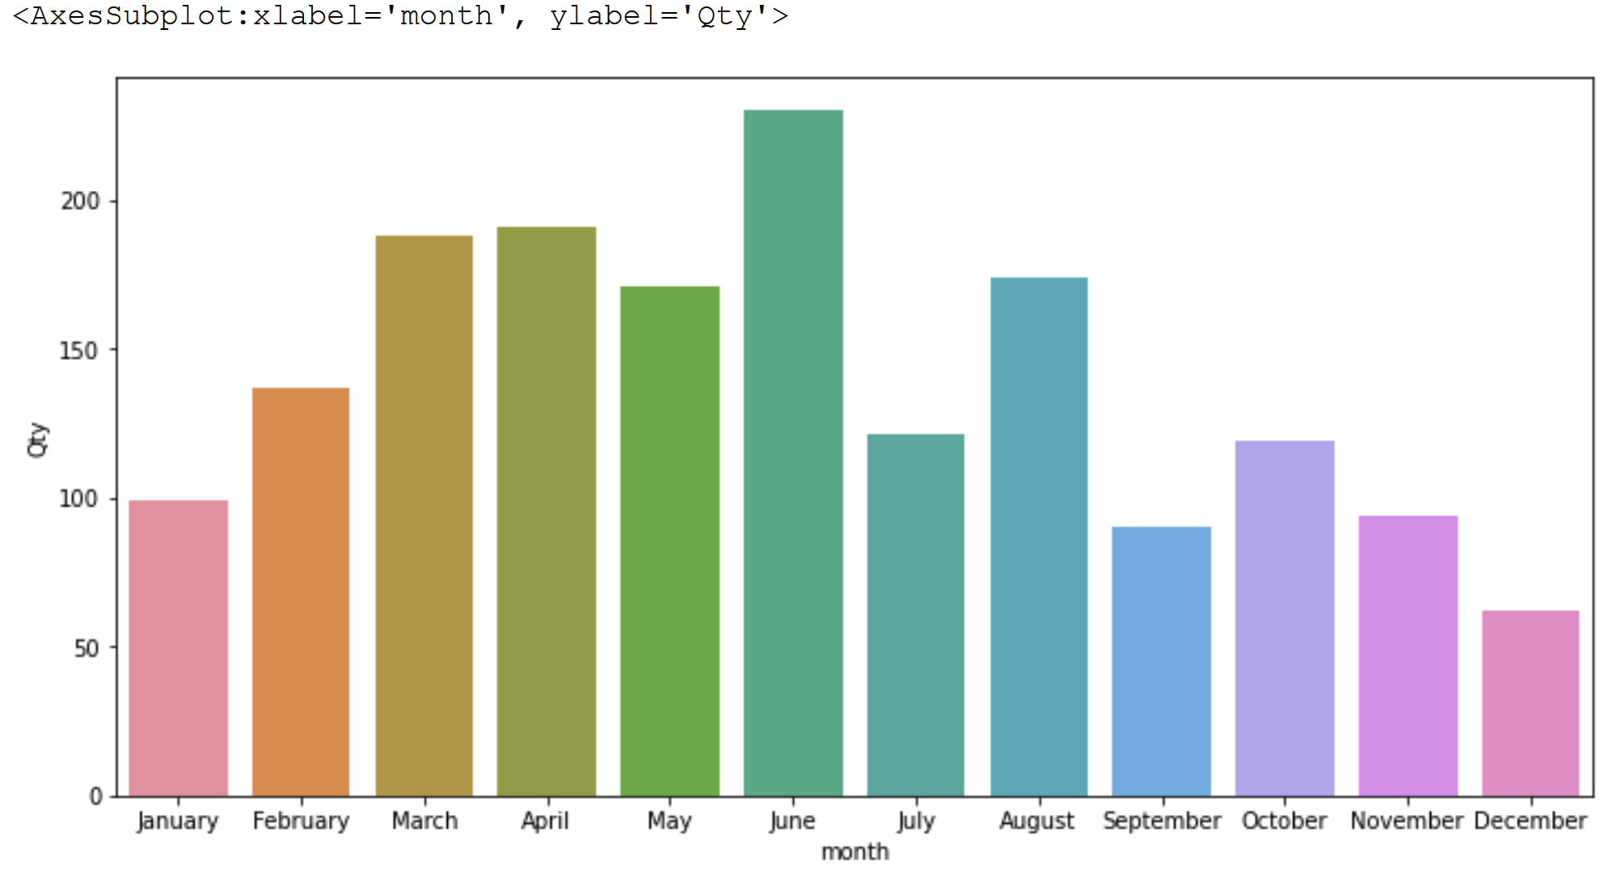
Descriptive Analytics: Best Months for Sales
Revenue
Number of orders
Notes:
*Lower priced items sold more in month of May

Slide 18
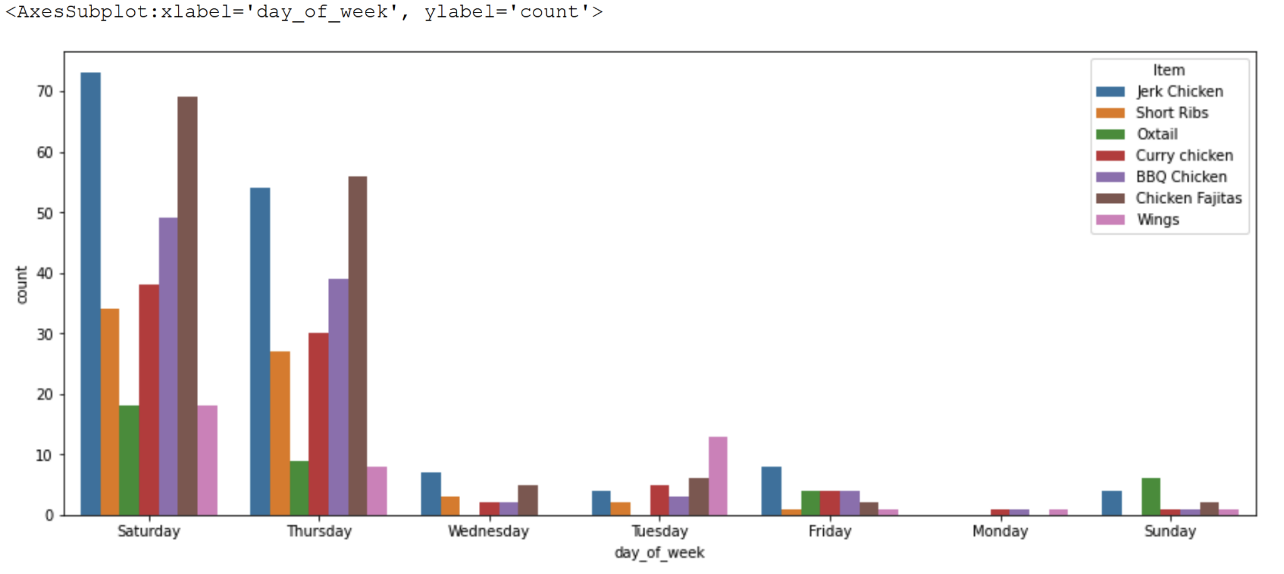
Descriptive Analytics: Best Days for Sales By Item
*Excludes Custom Items

Slide 19
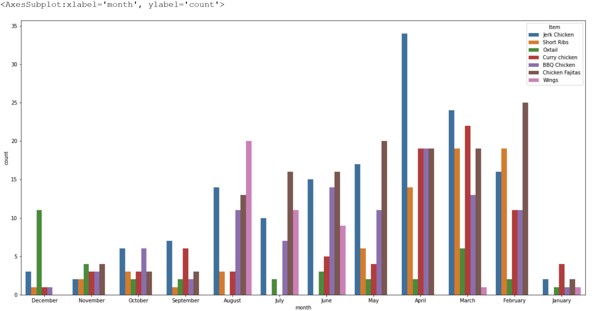
Descriptive Analytics: Breakdown of Monthly Sales by Item (Top 7)
*Excludes Custom Items

Slide 20
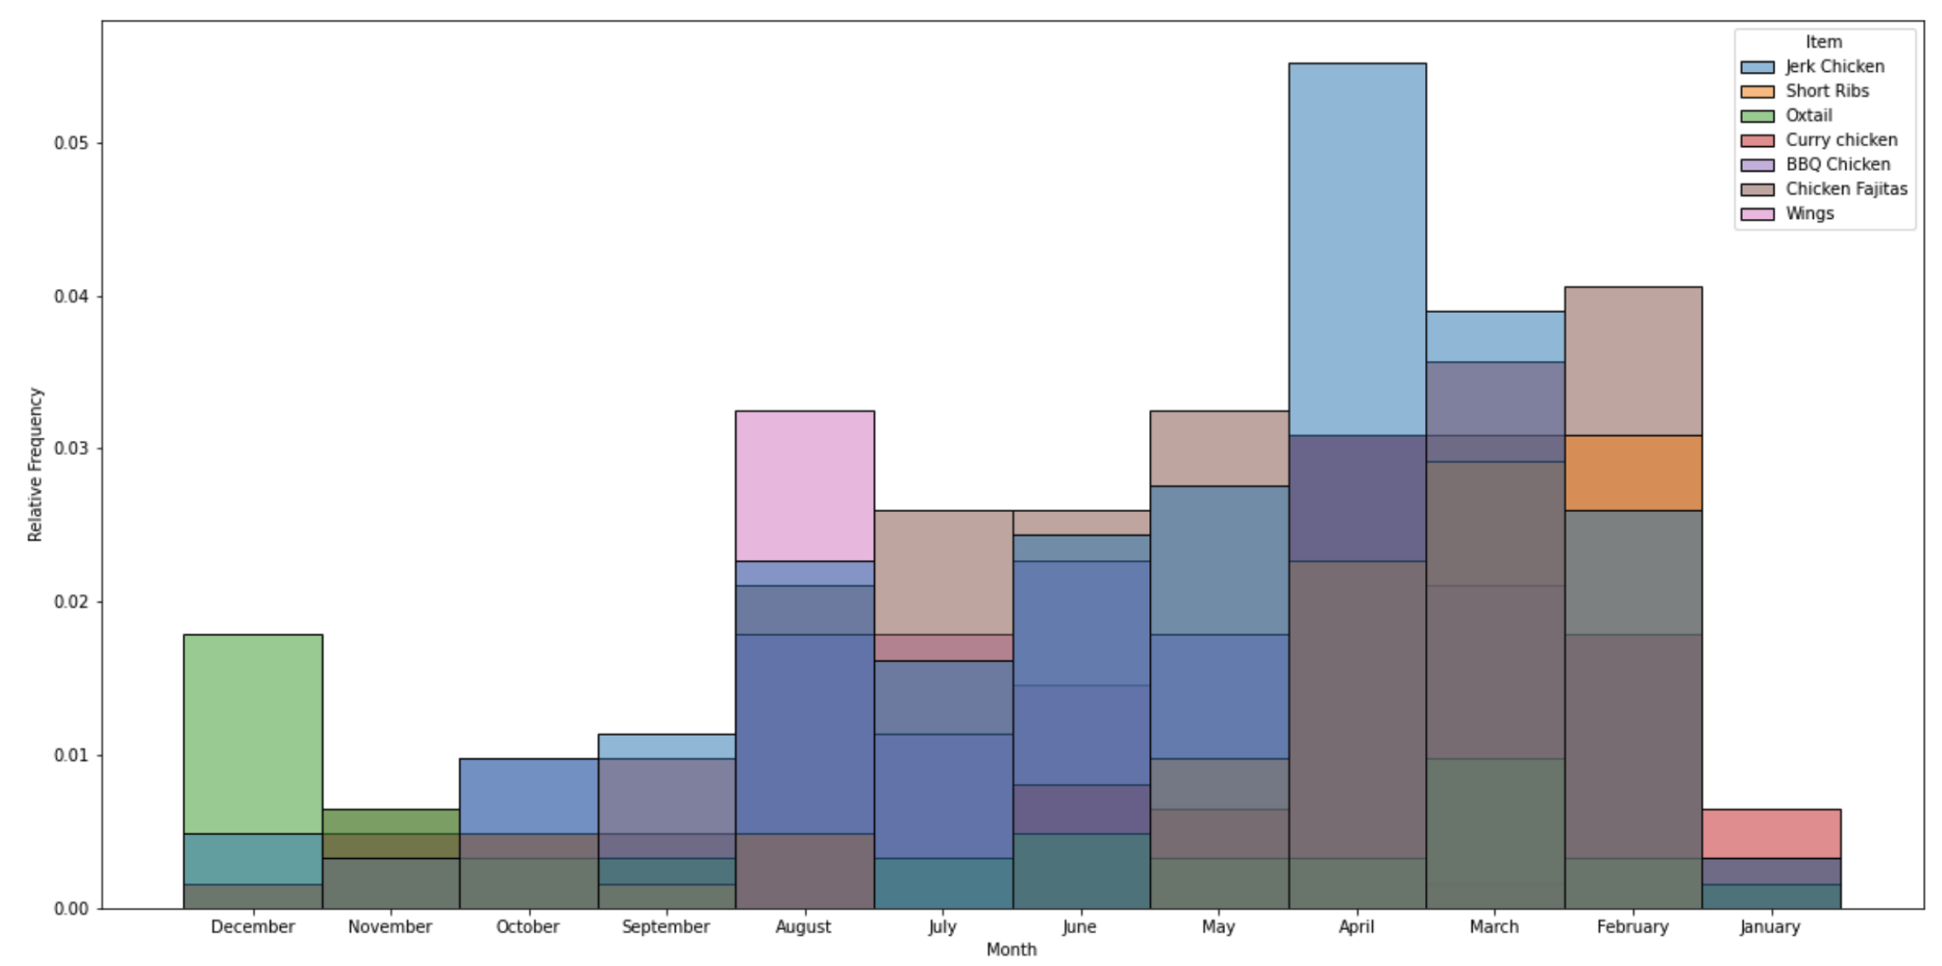
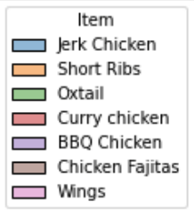

Descriptive Analytics: Relative Frequency of Item Sales per Month
*Excludes Custom Items

Slide 21
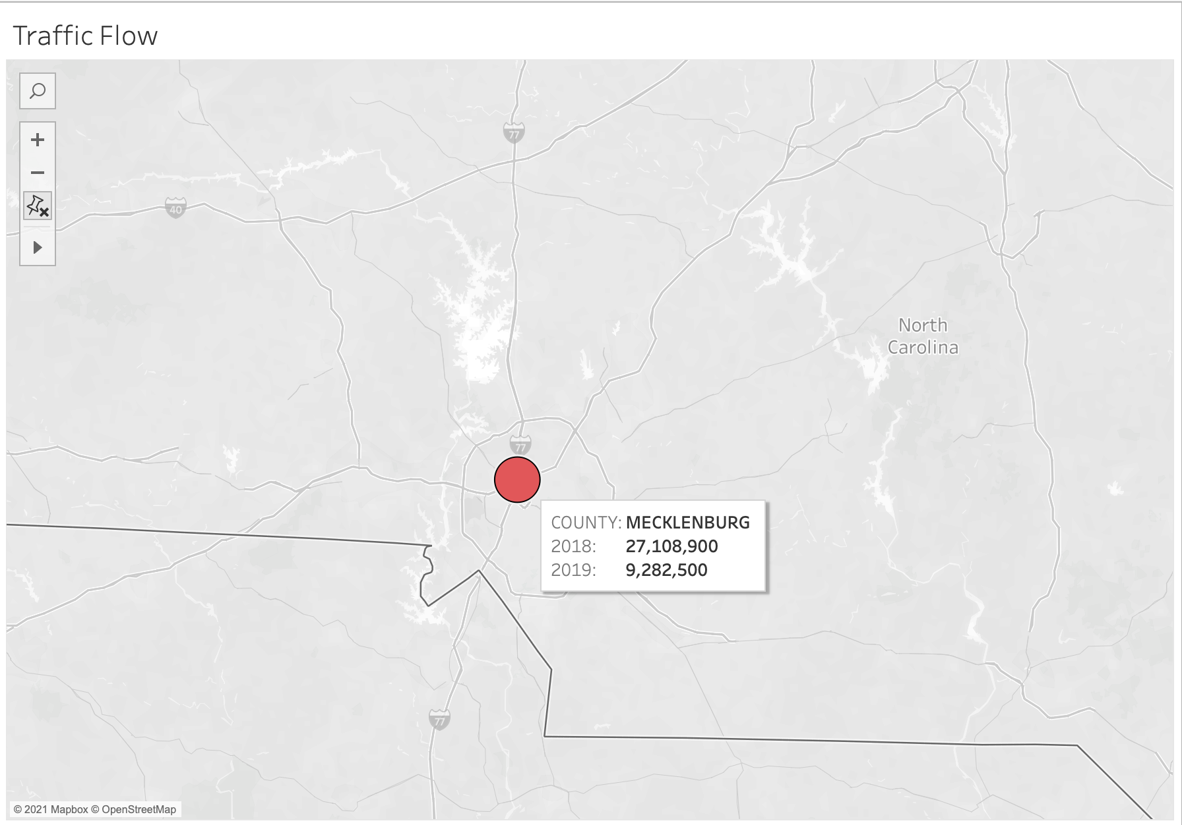
Descriptive Analytics: Traffic Volume per County
Notes:
It may seem feasible to conduct a majority of operations in Mecklenburg due to both its difference in size and traffic flow
Note: Mecklenburg has 20+ Caribbean cuisine locations, while Iredell has 0

Slide 22
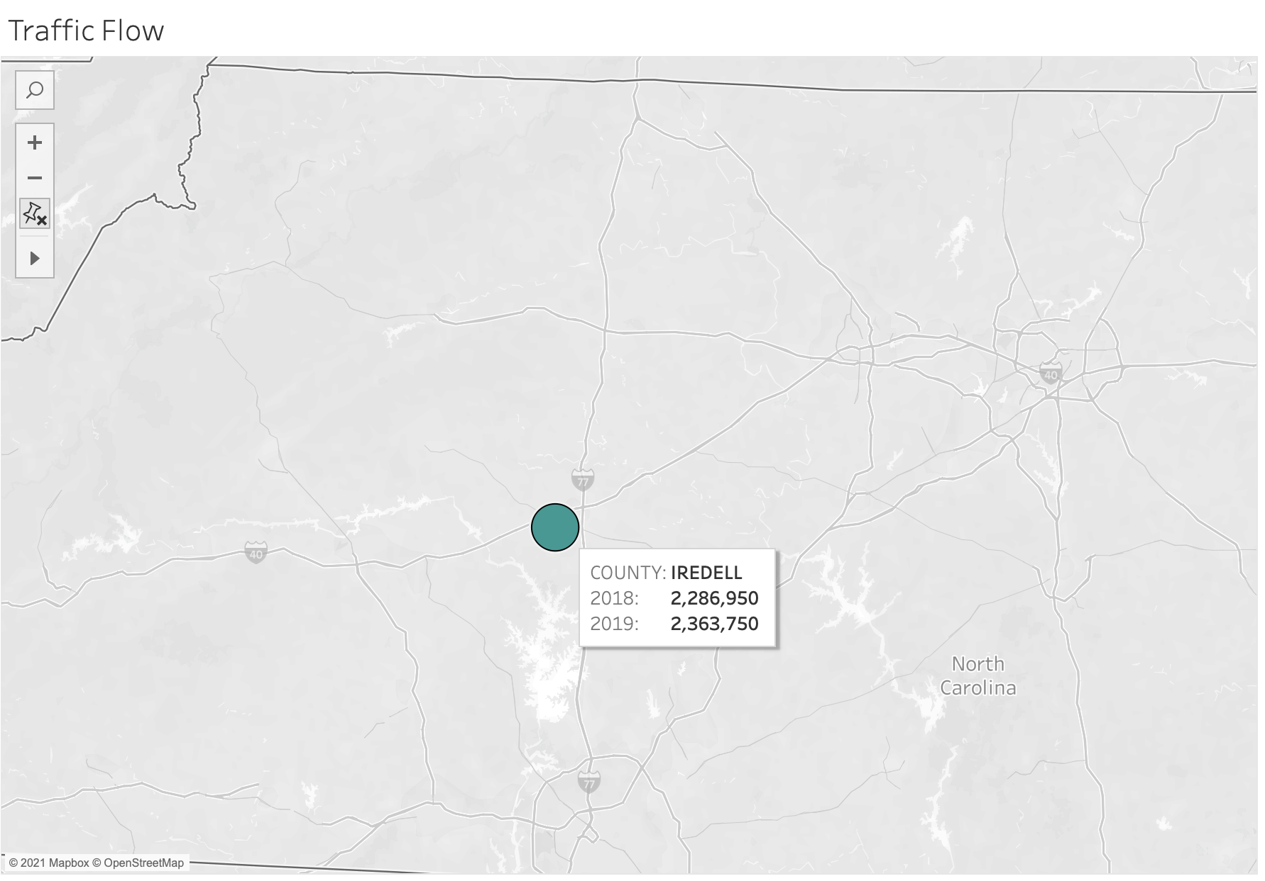
Descriptive Analytics: Traffic per County
Notes:
However, as indicated in the previous slide, ABZee has an opportunity to procure the entire market for caribbean cuisine in Iredell County given that competition is 0 in that area

Slide 23
Predictive Analytics: Method
ARIMA vs Prophet - Why Prophet?
Non linear trends with yearly, weekly seasonality
Robust on missing data
Handling of outliers
Prophet had better accuracy than ARIMA
Methodology:
Training data: 2 years transactional data
Testing data: 1 year (2020)
Cross validation: 30 days
Notes:
JYOTI

Slide 24
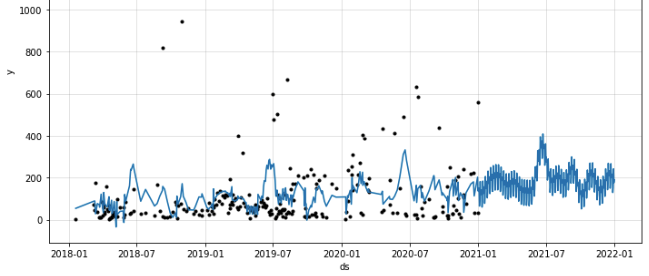
Predictive Analytics: Cash flow projection (Prophet)
GRAPH
Explanation
Notes:
JYOTI: Slightly positive trend, could be greater if sales didn’t slip in 2020

Slide 25
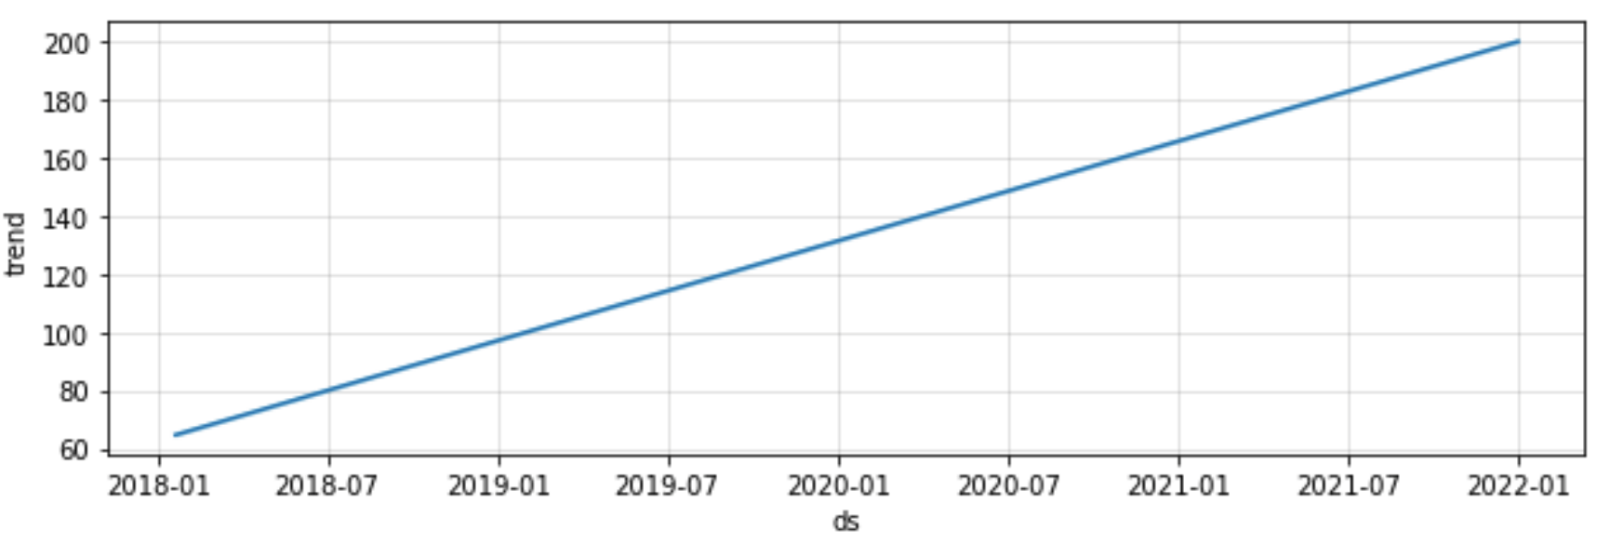
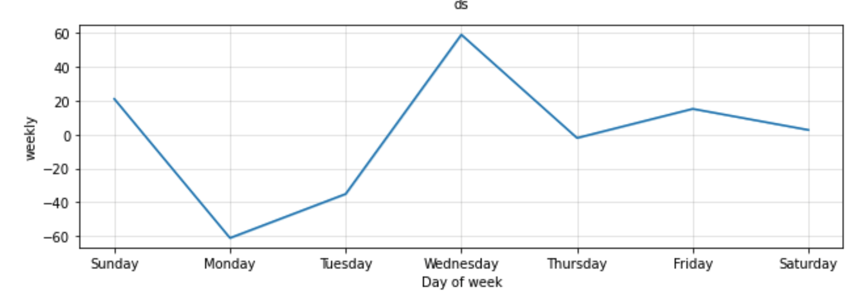
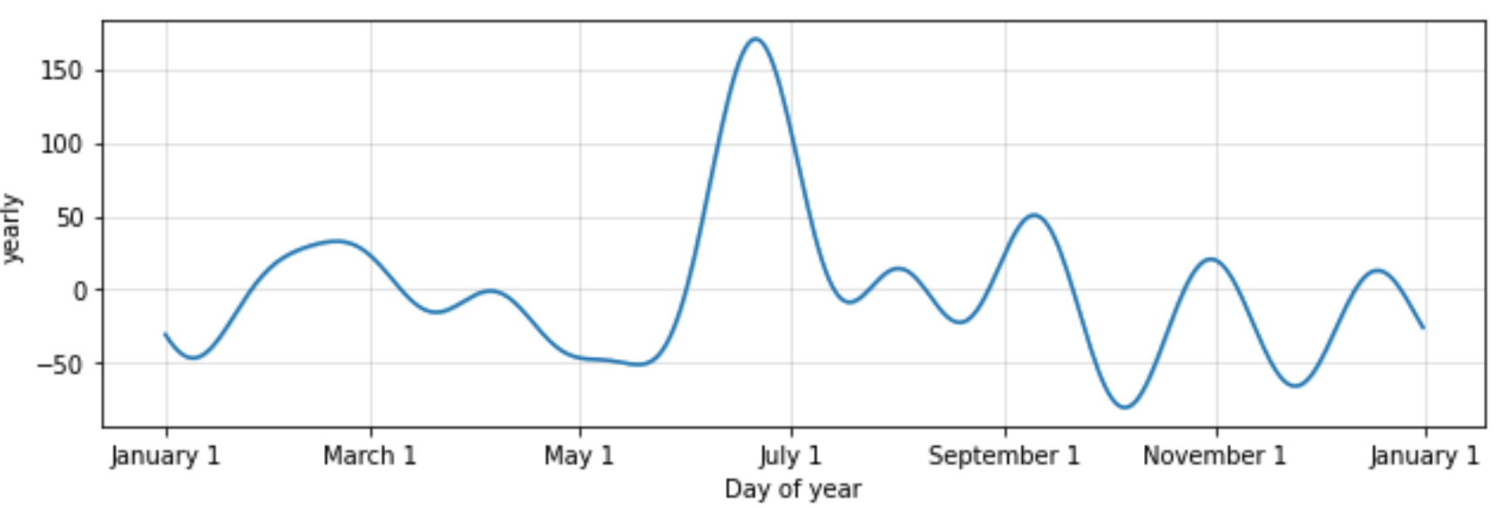
Predictive Analytics: Sales
Trend (non-periodic)
Predictions till end of 2021 shows that there continuous growth will be maintained
Weekday (Periodic)
The sales on Monday and Tuesday may remain below average sales for the year 2021
Yearly (Periodic)
The sales in the 2nd half of September and November may go down.
Month of June will be most profitable
Notes:
JYOTI

Slide 26
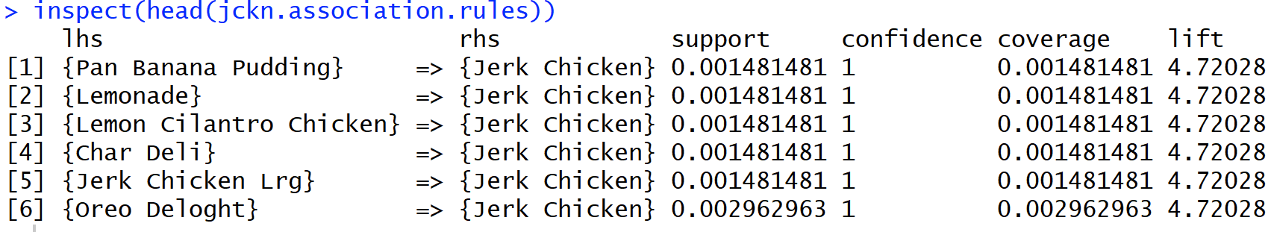
Association Rule - An Attempt
Notes:
JYOTI: Need more sales data to conduct proper association rule mining

Slide 27
Prescriptive Analytics: Next Steps for ABZ
All flavors of chicken are big sellers with highest returns
Oxtail should be the next focal point for sales, don’t rely on artificial scarcity and keep it stocked in inventory
Ensure all “Custom Items” are categorized for more accurate analysis
Location Recommendation: Majority operations should be conducted in Iredell County with continued event services in Mecklenburg
Mecklenburg for their booming population and traffic, and Iredell for the growth potential of Caribbean cuisine market

Slide 28
Prescriptive Analytics: Next Steps for ABZ
Best time to sell:
Increase activity during weekends and Thursdays
Offer incentives on Monday and tuesdays to pick up sales
June-August, March, September
Build a customer base for profiling - loyalty program, email list to send out to previous customers informing them on weekly schedule/events
Incentivize Google and Yelp reviews to improve click traffic, draw in new customers

Slide 29

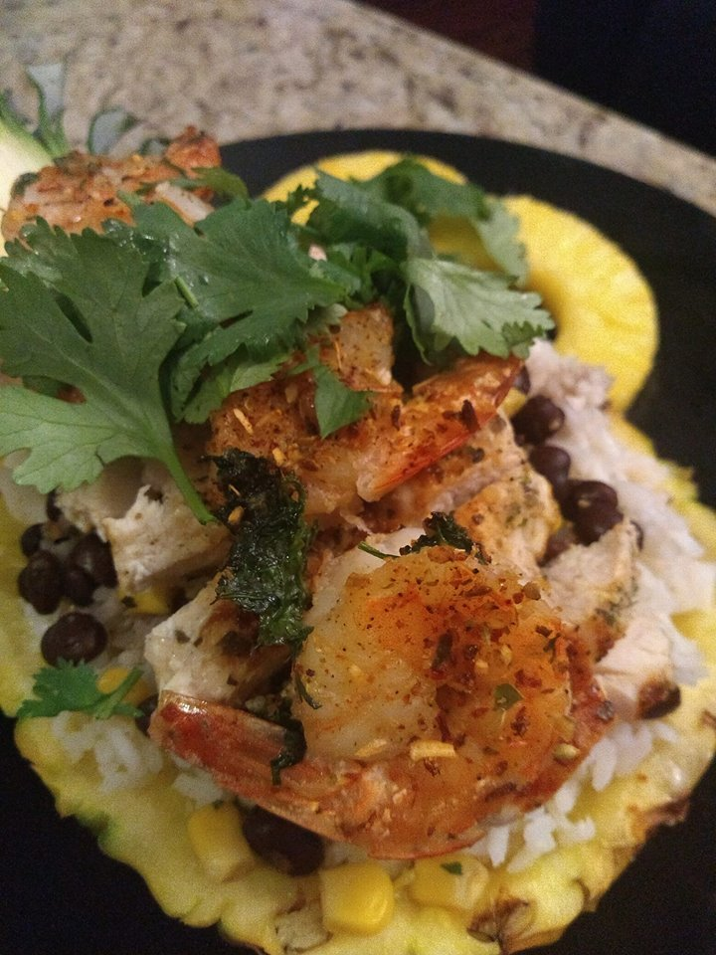
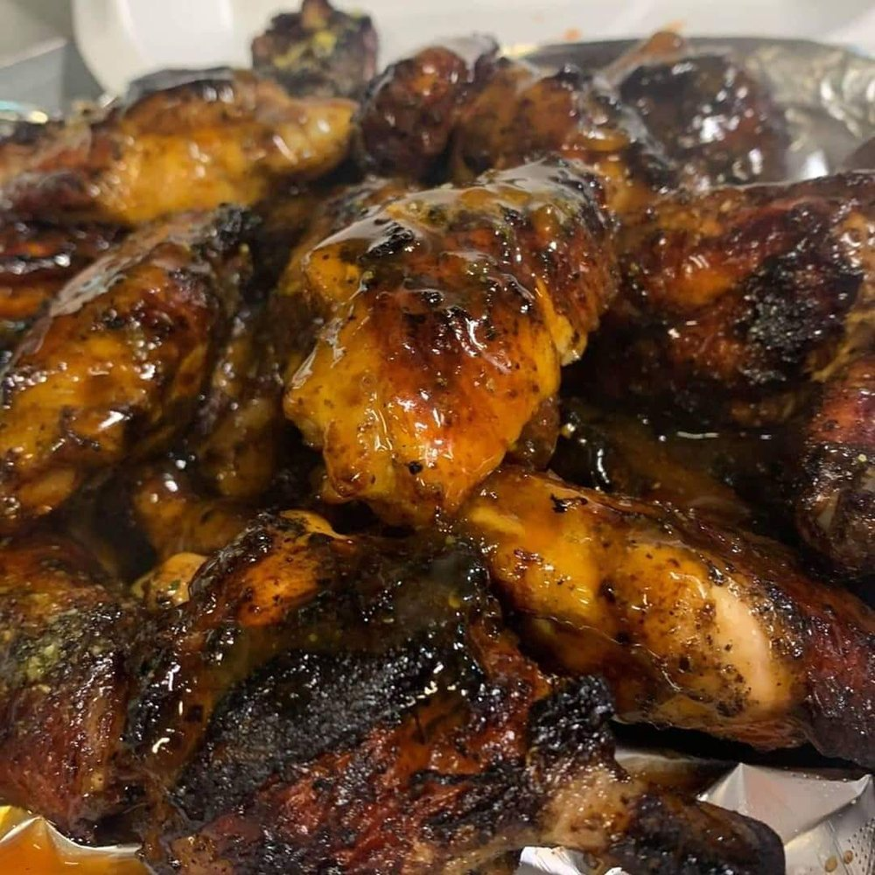
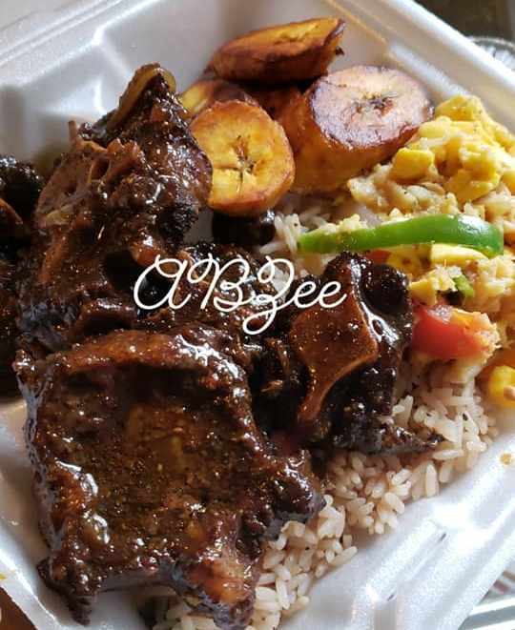
Thank you!
Any Questions?

